Slide 1
PL/SQL PRESENTATION
Name: Igizeneza Serge Benit
Student ID: 27311
Course: Database Development with PL/SQL (INSY 8311)
Lecturer: Eric Maniraguha
Academic Year: 2024–2025

Slide 2

Hotel Reservation System PL/SQL Oracle Database Solution for Hotels
Hotels struggle with overbooking, revenue loss & admin delays.
Goal: Automate bookings, prevent errors & improve management.
Users: Hotel managers, front desk, guests, & booking platforms.
Key Features: Easy reservations, secure payments & smart reports.
Expected Result: Fewer mistakes, better service & data-driven decisions.

Slide 3
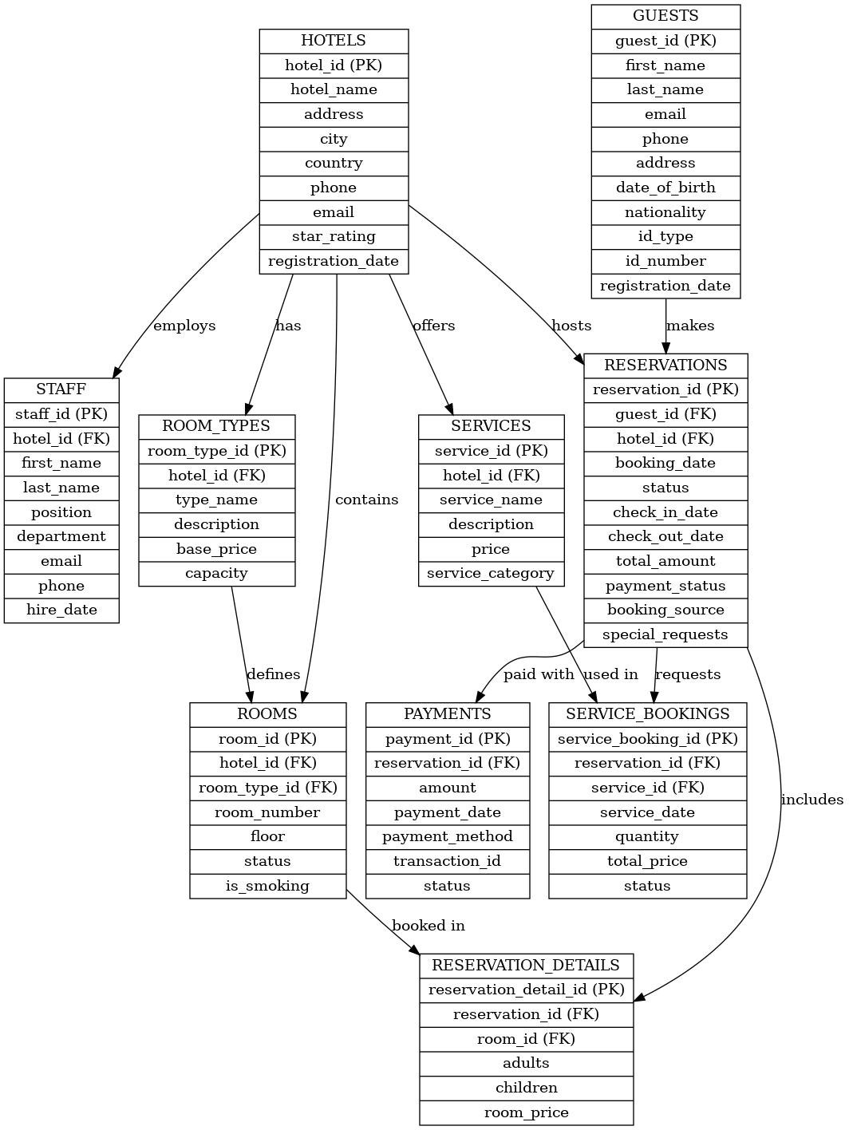
The diagram illustrates interconnections between
Hotels → Room Types → Rooms
Guests → Reservations → Reservation Details
Services → Service Bookings
Payments → Reservations
Staff → Hotel

Slide 4
Technical Implementation & Benefits
PL/SQL Implementation
Over 15 stored procedures for booking, checking room availability & handling payments.
Automated price updates, discount calculations & service requests.
Ensures secure transactions & prevents errors with strong validation.
Benefits for Hotels
40% less admin work: Saves staff time & reduces errors.
Faster service: Guests book & check-in smoothly without delays.
More revenue: Smart pricing & availability tracking prevent lost bookings.
Better decisions: Data reports help in setting prices, hiring staff & improving services.

Slide 5
Introduction
Development of a PL/SQL-based Oracle database system for hotel management.
Project addresses hotel challenges such as booking conflicts, manual data errors, and service tracking.
Uses PL/SQL for automation, data security, and integrity enforcement in hotel operations.

Slide 6
Problem Definition
Problem: Inefficient and error-prone manual hotel reservation and service management.
Context: Hotel front-desk and administration in mid-sized hospitality businesses.
Target Users: Receptionists, Hotel Managers, Staff Coordinators, and Service Desk Agents.
Goals: Streamline room reservations, track services, secure guest data, and avoid double bookings.

Slide 7
Methodology & Tools
Adopted a phased development approach: design, build, test, and secure.
Tools used: Oracle XE, SQLcl, PL/SQL, SQL Developer.
Project documentation and code versioning via GitHub.

Slide 8
Database Design
Designed comprehensive logical and physical data models aligned with hotel management requirements.
Applied Third Normal Form (3NF) principles to eliminate redundancy and ensure data consistency.
Defined primary and foreign keys, along with integrity constraints, to enforce relational accuracy and secure data flow across entities
Diagram

Slide 10
Table Implementation
Implemented ten well-structured tables aligned with the logical model, covering core hotel operations such as bookings, payments, services, guests, and staff.
Used appropriate data types to support precision, consistency, and flexibility across modules.
Defined PRIMARY KEY and FOREIGN KEY constraints to ensure relational integrity and enforce business rules across entities like Hotels, Reservations, and Rooms.
Simulated real-world operations by inserting test data representing guests, bookings, service usage, and payments.
Table Structure

Slide 11
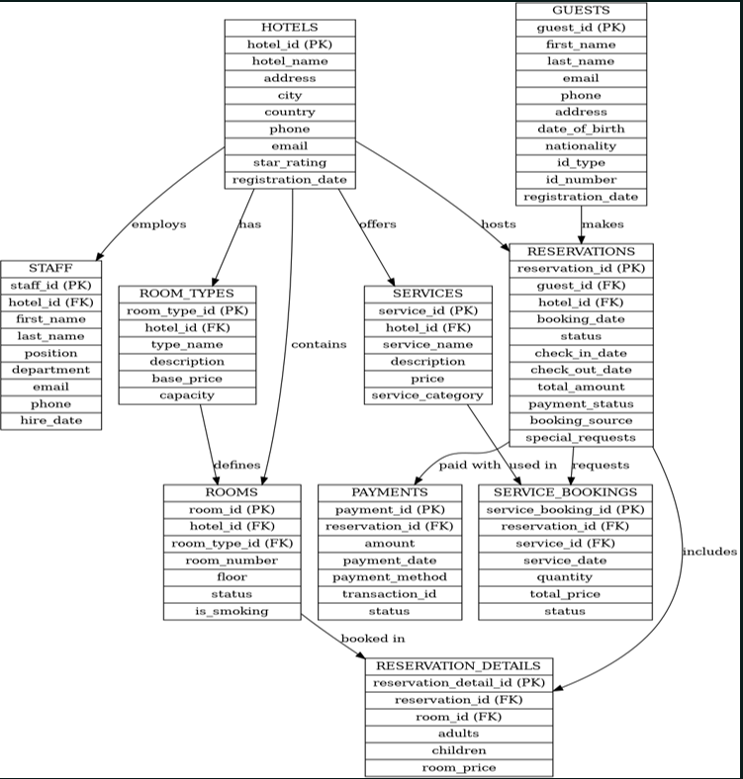

Slide 12
PL/SQL Procedures & Triggers
Developed modular PL/SQL procedures to handle core operations such as reservation management, guest lookup, and service billing.
Implemented security triggers to restrict INSERT, UPDATE, or DELETE actions on sensitive tables during weekdays and predefined public holidays.
Used compound triggers to manage complex multi-row operations, ensuring consistent behavior during bulk updates or cascading transactions.

Slide 13
Results & Benefits
The hotel management system was successfully implemented, demonstrating efficient data flow across interconnected modules such as reservations, guest profiles, room availability, and payments.
PL/SQL procedures and triggers provided automation of key operations and robust enforcement of business rules.
The system is secure, modular, and scalable — well-positioned for future enhancements such as a web-based interface or real-time analytics dashboards.

Slide 14
Conclusion & Recommendations
PL/SQL proved to be a powerful tool for developing a secure, transactional, and logically structured database system tailored to the hospitality sector.
It enabled the enforcement of critical operational rules while maintaining data integrity and reliability.
Recommendations include integrating a front-end interface for improved usability and implementing user access control for better security.
Future Work involves deploying the system to the cloud and enabling third-party integrations via APIs.
References: Oracle Documentation, AUCA Course Materials, GitHub Repository.

